Slide 1


Angular best practice
19-08-2016
San NGUYEN - SSE FRONT-END

Slide 2

AGENDA
Manually start up angular application
Should bind data to $scope or Controller?
Pretty URLs with HTML5 mode
Angular dependency injection
Angular view rendering and $timeout
Manually compile and link a template to DOM element
Deal with Form custom Validation
Deal with raw object like File and Image
Q&A

Slide 3


Start up angular application

Slide 4

How HTML can understand a new markup element?
When angular trigger start up application process?
Can we do and finish action before trigger start up application process?

Slide 5
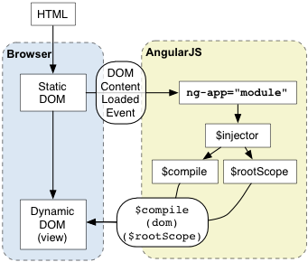
Using ng-app
In angular.js (line 31762):
jqLite(window.document).ready(function() { angularInit(window.document, bootstrap); });
In angularInit function (line 1662):
bootstrap(appElement, module ? [module] : [], config);
Notes:
https://docs.angularjs.org/guide/bootstrap
Using manual initialization if you need to perform an operation before Angular compiles a page
5

Slide 6
Angular and Cordova
There is a hybrid application building with Cordova. When starting up, application must check User info in device storage and using this info for authentication process (if existed).
Cordova consists of two code bases: native and JavaScript
This means the web app may potentially call a Cordova JavaScript function before the corresponding native code becomes available.
Listen deviceready event and starting application in callback fucntion.

Slide 7
Using angular.bootstrap
(function (window) { angular.module("app“, []); window.bootstrap = bootstrap; function bootstrap (element) {
angular.element(document).ready(function () { angular.bootstrap(element, ["app"]); }); } })(window);
In deviceReady function of Cordova index.js file:
window.bootstrap(document);

Slide 8
Binding data to $scope or Controller

Slide 9
Why sometimes cannot get data that is bind to $scope?
When we should bind data to $scope or Controller
Why sometimes $scope.$watch() does not work?

Slide 10
Angular ng-if
The ng-if directive removes or recreates a portion of the DOM tree based on an {expression}
When an element is removed using ng-if its scope is destroyed and a new scope is created when the element is restored.
ng-if recreates elements using their compiled state.
If we directly bind data to $scope for elements that are based on ng-if, we cannot get their values in controller. We should bind data to Controller or parent $scope.

Slide 11
Bind data to $scope or Controller
$scope:
Prototypical inheritance -> child scopes prototypically inherit from their parents.
Provide API $watch and $apply.
Support publishing and subscribing events using $emit, $broadcast, or $on
Scopes can be nested. Nested scopes are either "child scopes" or "isolate scopes "
Controller:
Controllers are constructed, "newed" up. Provide a single new instance.
Using ControllerAs for more contextual.
Work well with ng-if.

Slide 12
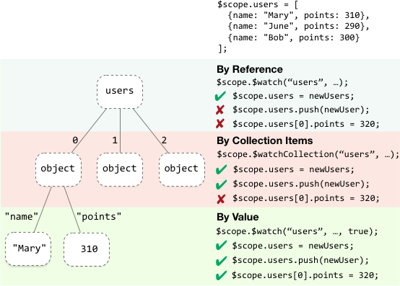
$scope.$watch()

Slide 13
Pretty URLs with HTML5 mode

Slide 14
Can remove hash character (#) on URLs of single web page application?
Why must use URL rewriting on server side when Using HTML5 mode?

Slide 15
The usage of hashbang in single web page
Single web page characteristics:
All resource files will be load at the initialization application.
The content of a view will be retrieved through AJAX request.
Not reload all page of application, we just reload the necessary view that content changed.
How we deal with window history in Single-Page application? How to keep track the state of application?
Using hashbang (#) – Like multi-page app where every state usually bound to a different URL.
Using HTML5 history feature ( history.pushState() & history.replaceState(). These methods work in conjunction with the window.onpopstate event )

Slide 16
Using HTML5 history feature on Angular app
Identify using HTML5 history in angular module Config function.
angular.module(“app”).config(Configuration);
function Configuration ($locationProvider) {
$locationProvider.html5Mode(true);
}
Specify the url base in the head of your main html file.
<base href="/“>
Configure Web Server to using rewriting URLs mode.
Notes:
http://www.frontendjournal.com/html5-pushstate-and-single-page-apps/

Slide 17
Angular dependency injection

Slide 18
What is difference between Angular Module and AMD?
How to deal with circular dependency error?

Slide 19
Angular Module and AMD
The Asynchronous Module Definition (AMD) API specifies a mechanism for defining modules such that the module and its dependencies can be asynchronously loaded.
Angular modules solve the problem of removing global variables from the application and provide a way of configuring the injector. They don't try to solve the problem of script load ordering or lazy script fetching.
Angular injector only carries out the following steps:
Load the module definition(s) that you specify in your application.
Register all Providers defined in these module definition(s).
When asked to do so, lazily instantiate services and their dependencies, via their Providers, as parameters to an inject-able function.
Notes:
https://docs.angularjs.org/tutorial/step_09
When the application bootstraps, Angular creates an injector that will be used to find and inject all of the services that are required by your application.
Angular modules solve the problem of removing global variables from the application and provide a way of configuring the injector. As opposed to AMD or require.js modules, Angular modules don't try to solve the problem of script load ordering or lazy script fetching. These goals are totally independent and both module systems can live side-by-side and fulfill their goals.
19

Slide 20
Deal with circular dependency error
commonUtil -> userService -> baseService -> commonUtil.
Using $injector to manual inject dependencies in each service’s function.
angular.module("app").factory("userService", UserService);
UserService.$inject = ["$injector"];
function retrieveData () { var baseService = $injector.get("baseService"); baseService.callGetAPI("http://127.0.0.1/api/user").then(function (data) { //TODO }); }
Notes:
20

Slide 21
View rendering and $timeout

Slide 22
In the directive where we put manipulate DOM code?
How can we listen template is compiled to view?

Slide 23
Manipulate DOM in Directive
Put manipulate DOM element code on link function of directive → only apply for usual template.
function linkFn ($scope, element, attrs) {
element.find(“template element selector”);
}
For asynchronous template → Using $timeout in link function.
function linkFn ($scope, element, attrs) {
$timeout(function () {
element.find(“template element selector”);
});
}
Notes:
23

Slide 24
Why use $timeout
Browser render includes 2 tasks:
DOM rendering
JavaScript execution
→ Using $timeout. We will push it to JS execution queue and it will be run after DOM rendering.
Notes:
https://docs.angularjs.org/tutorial/step_09
24

Slide 25
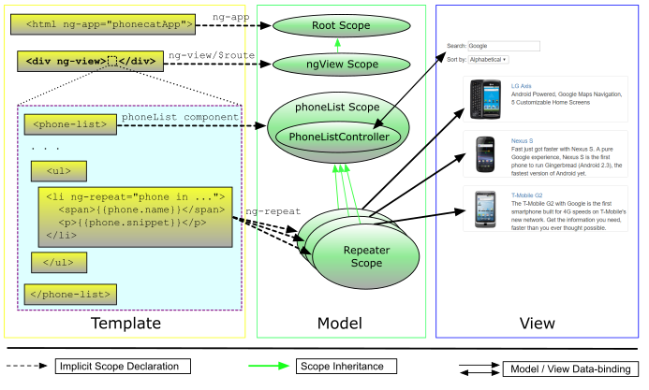
Angular view rendering with ngView
Notes:
https://docs.angularjs.org/api/ngRoute/directive/ngView
$viewContentLoaded
$routeChangeSuccess
If ngView is contained in an asynchronously loaded template (e.g. in another directive's templateUrl or in a template loaded usingngInclude) => Using $timeout to check whether subView is rendered or not.
25

Slide 26
Angular view rendering with ngView
To Listen template of ng-view is compiled to view → Using $timeout in Controller
angular.module(“app”).
controller(“phoneController”, PhoneController );
PhoneController.$inject = [“$timeout”];
function PhoneController ($timeout) {
$timeout (function () {
//Code to get phone list element
});
}
Notes:
26

Slide 27
Manually compile and link a template

Slide 28
Can manually compile a template to current view and how to implement that?

Slide 29
Manually compile and link a template
There is a HTML template that can be get from server. The template can contain directive and must link with current controller and $scope to retrieve data.
We must compile this template to view and append this view to current page.
function getTemplateFromServer () {}
function controllerFn ($compile, $document, $scope) {
getTemplateFromServer().then(function (template) {
var angularTemplate = angular.element(template);
var linkFn = $compile(angularTemplate);
var view = linkFn($scope);
$document.find(“.selected-element”).append(view);
});
}
Notes:
29

Slide 30
Deal with Form custom validation

Slide 31
What should we do to create a custom validation that link to modelController.$error object?

Slide 32
Custom Validation
Create custom directive & use $validators of ngModelController.
angular.module(“app”).
directive(“customValidation”, ValidationDirective);
ValidationDirective.$inject = [“validationService”];
function ValidationDirective () {
return {
require: “ngModel,
link: linkFn
};
function linkFn ($scope, element, attrs, modelContrller) {
modelContrller.$validators.customValidation = validationService.custome;
}
}
Notes:
https://docs.angularjs.org/guide/forms
The directive must require ngModel
$validators function receives modelValue & the viewValue as parameters
Validation happens after successfully running $parsers and $formatters
Failed validators are stored by key in ngModelController.$error
32

Slide 33
Deal with raw object like File and Image

Slide 34
What is Blob object?
How can create a Blob object to store Image data?

Slide 35
What is Blob Object
Blobs are immutable objects that represent raw data.
File is a derivation of Blob that represents data from the file system.
Use FileReader to read data from a Blob or File.
Blobs allow us to construct file like objects on the client that we can pass to APIs that expect URLs instead of requiring the server provides the file.
we can construct a blob containing the data for an image → using URL.createObjectURL() to generate a URL → pass that URL to HTMLImageElement.src to display the image.
Notes:
https://docs.angularjs.org/guide/forms
The directive must require ngModel
$validators function receives modelValue & the viewValue as parameters
Validation happens after successfully running $parsers and $formatters
Failed validators are stored by key in ngModelController.$error
35

Slide 36
Create Blob object contains Image data
we have a file object that contains Image data → Using file.slice() to clone another blob object.
function cloneBlob (source) {
if (source instanceof Blob) {
return source.slice(); // clone file
}
}

Slide 37
Q&A

Slide 38
THANK YOU

Slide 39
Thanks for the contribution
A.Khoa Nguyen Phu
Khiem Huynh Khiem
Phuong Nguyen Dang

Slide 40
Demo
Link to jsfiddle

